Slide 1
CS465-Midterm
Genetic Algorithms-Pipeline
By Hermann Yepdjio

Slide 2
Introduction
The project was about optimizing the operations of a crude oil extraction plant. As requirements the program should be able to find a solution that would
maintain each one of the 16 tanks of the pipeline to about 45% of their capacity,
maintain a constant delivery flow of about 160 gallons per hour for the whole plant,
maximize the lifespan of the plant,
minimize the electricity consumption.

Slide 3
Tools we used
To solve this problem, we considered implementing a genetic algoritm from scratch following some examples seen in class and some others found on the internet

Slide 4
Steps
Create a station class
Create an initial population of 16 stations
Initialize the population with random values
Simulate the functioning of the plant for 48 hours
Use the Roulette-Wheel to pick 2 parents
Apply Cross-Over to obtain new children
Replace old individuals with new children

Slide 5
Steps
8. Simulate again
9. Repeat the last 4 steps until the solution does not improve anymore
10. Apply mutation and go back to step 4

Slide 6
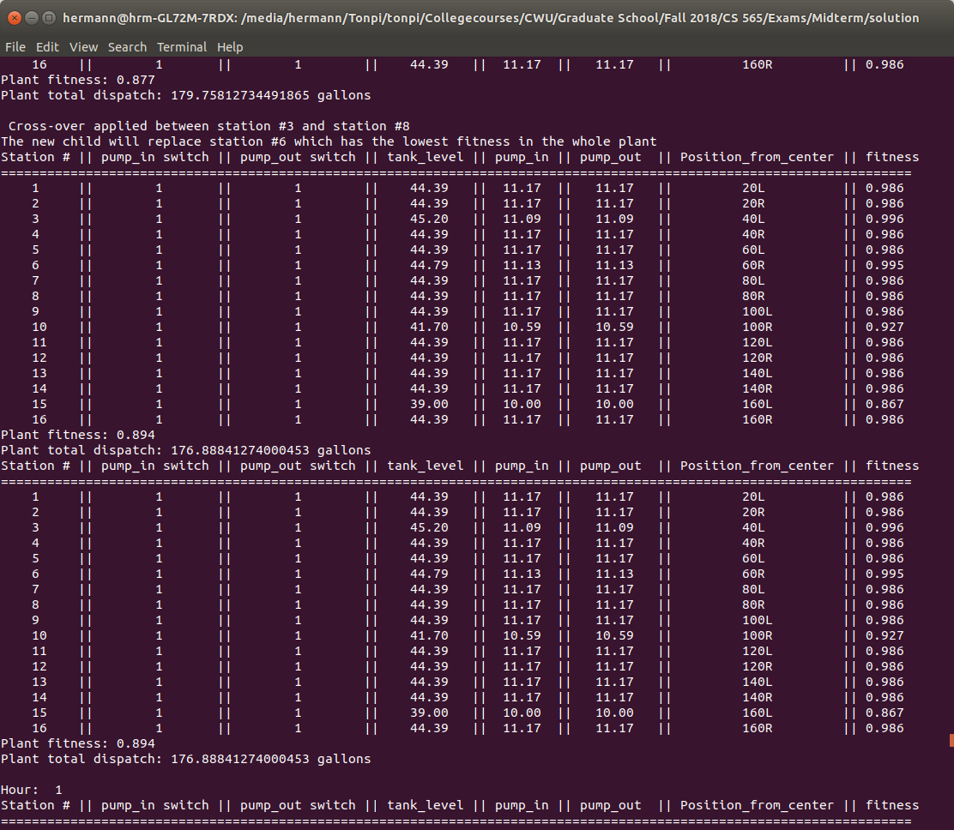
Results

Slide 7
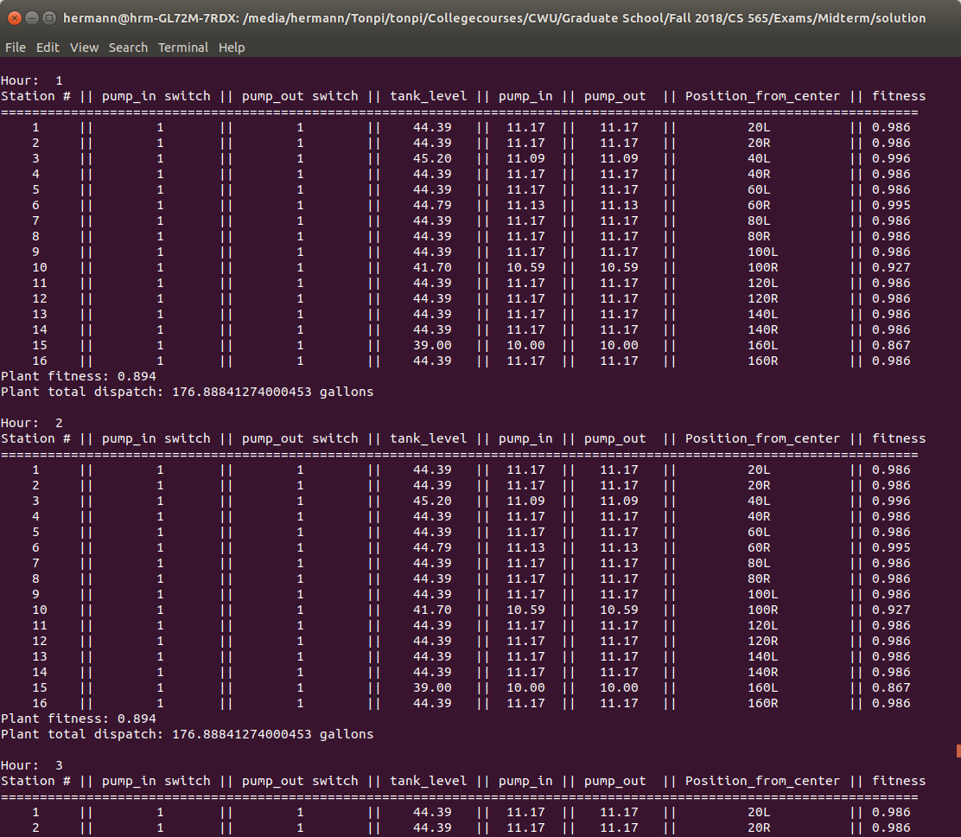
Results

Slide 8
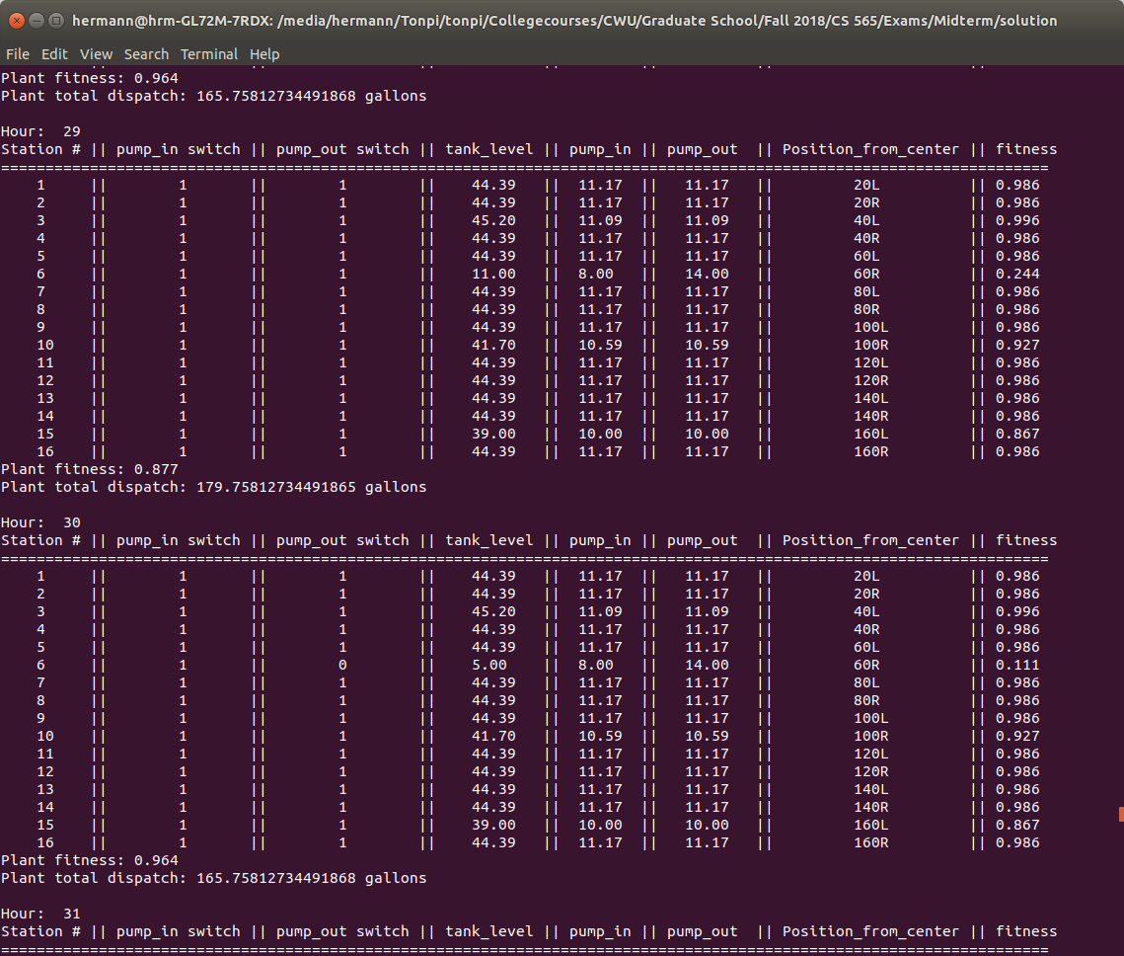
Results

Slide 9
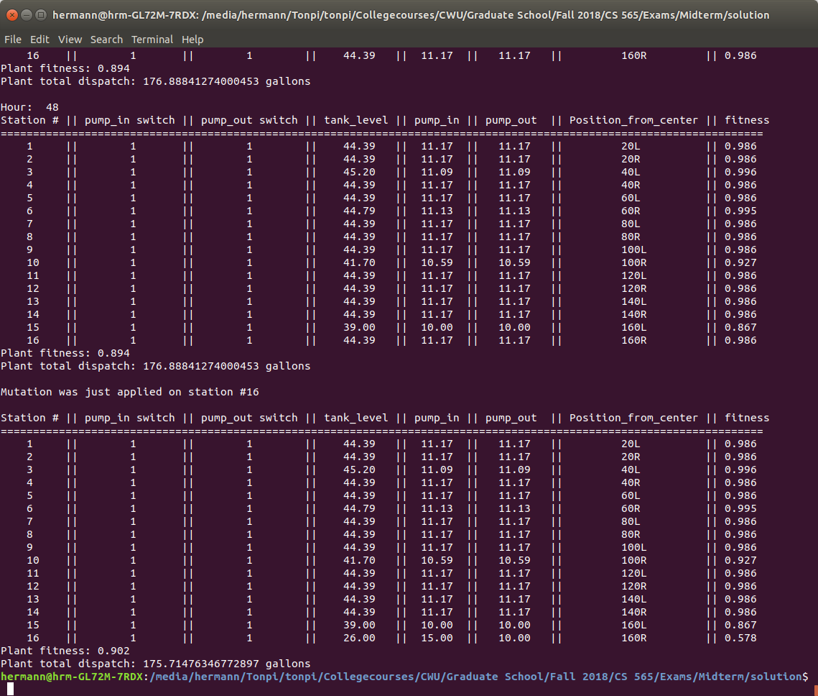
Results

Slide 10
Results

Slide 11
Conclusion
To prevent the program to run for ever trying to find the perfect solution, I set it to stop whenever it finds a solution that has a plant fitness of 0.9 and above and an average station fitness of 0.95 and above

